Slide 1
Student record management system
MADE BY:
ANISHA-CO19310
ANMOL-CO19312
SHIVAM-CO19359

Slide 2
INTRODUCTION
This project is used for managing record of students. The user can manage student information by adding, updating, removing, viewing and searching for details. This project contains limited features, but the essential ones.
Talking about the features of Student Record management system, the user can add various information of the students. For that, the user has to provide admission number, full name, standard,gender and marks(out of 500). The user can also modify all the available records easily. Before modifying the student’s record the user has to enter the respective admission no. which shows the old available record. After that, the user can modify each and every field. Deleting a record is too simple here, the user just has to enter the admission no. of the student. In order to view student record, the user has to search for it. It is done by entering the admission no.bof the student. Then the system displays each and every available detail. The system creates an external file to store the user’s data permanently.

Slide 3
CONTENTS
Get data of students:
This feature allows you to add general information in records. That includes the student’s name, admission number,gender,standard and marks obtained. All the added records in this student management system are stored in file.
Display data of students:
The void showData() function in this project has been used for this feature. It shows the record of all the students added in file.

Slide 4
Search record of student:
The void searchData() function is used for this purpose. In order to view the record of a student you have to enter the admission no of the student you want to search. Then the system displays the details of that student.
Delete records of students:
This feature is used to delete the record of a particular student. The function void deleteData() is used for this purpose. You have to enter the admission no of that student and then his/her record is deleted and moved to trash.
Modify student’s data:
This feature is used to edit the record of a particular student. For this admission no of that student is sought. The record of the student is hence modified. If no record of student is found in file, the system
displays “The admission No. not found....”

Slide 5
Read deleted records of students from trash:
If you have deleted the record and you want to read it again then using the function void getTrash() , this can be done. Hence, data reading from trash file is done .

Slide 6
HEADERS FILE USED
iostream:
iostream stands for input/output standard stream.This header file contains definitions to objects like cin and cout.
iomanip:
It provides a set of manipulator function to manipulate outputformats.The providee the same features as that of ios clas functions.
fstream:
This header file is responsible to do function on files like open, close,edit.
stdlib:
It is the header of general purpose sandard library of c++programming language which includes function involving memoryAllocationn,process control, conversion, and others.

Slide 7
CONCEPTS USED

Slide 8
Use of IOSTREAM.H
Loops:
A loop is a programming structure that repeats a sequence of instructions until a specific condition is met. The do/while loop is a variant of the while loop. It is exit control loop. This loop will execute the code block once, before checking if the condition is true, then it will repeat the loop as long as the condition is true.

Slide 9
Switch statement:
A switch statement allows a variable to be tested for equality against a list of values. Each value is called a case, and the variable being switched on is checked for each case.The compiler will execute the block of code associated with the case statement until the end of switch block, or until the break statement is encountered. The break statement is used inside the switch to terminate a statement sequence. When a break statement is reached, the switch terminates, and the flow of control jumps to the next line following the switch statement.
Class:
A class in C++ is the building block, that leads to Object-Oriented programming. It is a user-defined data type, which holds its own data members and member functions, which can be accessed and used by creating an instance of that class.A class is defined in C++ using keyword class followed by the name of class. The body of class is defined inside the curly brackets and terminated by a semicolon at the end. Data members are the data variables and member functions are the functions used to manipulate these variables and together these data members and member functions
defines the properties and behavior of the objects in a Class.

Slide 10
Use of fstream.h
File handling
Files are used to store data in a storage device permanently. File handling provides a mechanism to store the output of a program in a file and to perform various operations on it.A stream is an abstraction that represents a device on which operations of input and output are performed. A stream can be represented as a source or destination of characters of indefinite length depending on its usage.ofstream: Stream class to write on filesifstream: Stream class to read from filesfstream: Stream class to both read and write from/to files.

Slide 11
File mode parameter:
File mode parameter specifies the purpose for which the file is opened. In C++, for every file operation, exists a specific file mode. These file modes allow us to create, read, write, append or modify a file. The file mode parameter can take one or more of constants defined in the class ios. ios::inSearches for the file and opens it in the read mode only(if the file is found). ios::outSearches for the file and opens it in the write mode. If the file is found, its content is overwritten. If the file is not found, a new file is created. Allows you to write to the file. ios::appSearches for the file and opens it in the append mode i.e. this mode allows you to append new data to the end of a file. If the file is not found, a new file is created."ios::binary"Searches for the file and opens the file(if the file is found) in a binary mode to perform binary input/output file operations

Slide 12
Use of stdlib.h
system() in C/C++system() is used to invoke an operating systemcommand from a C/C++ program.stdlib.h or cstdlib needs to be included to call system.Using system(), we can execute any command that can run on terminal if operating system allows. system(“pause”) is used to execute pause command and make the screen/terminal wait for a key press, and system(“cls”) is used to make the screen/terminal clear.

Slide 13
Use of iomanip.h
The header <iomanip> contains the functions that we can use to format the output of the C++ program. These functions can be used one at a time or together to make the output of our program more presentable.

Slide 14
output

Slide 15
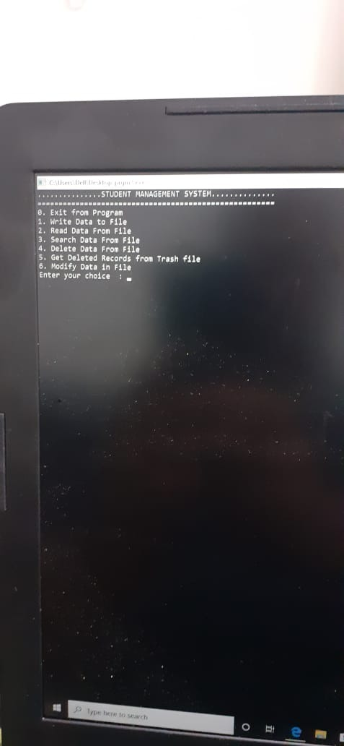

Slide 16
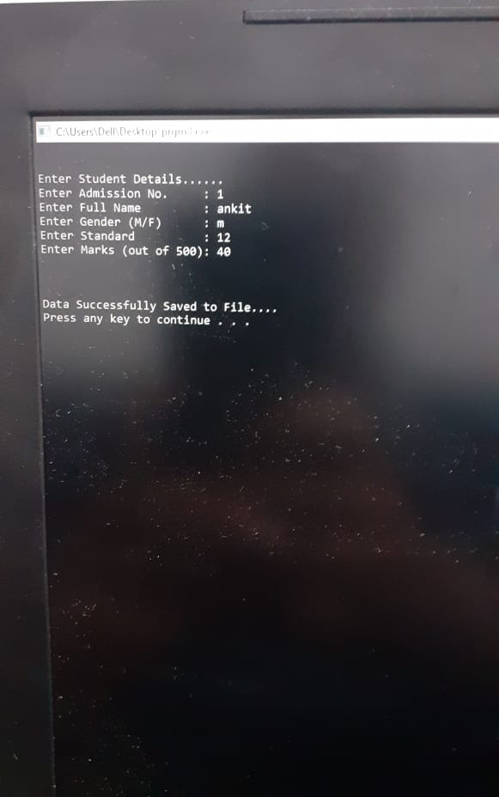

Slide 17
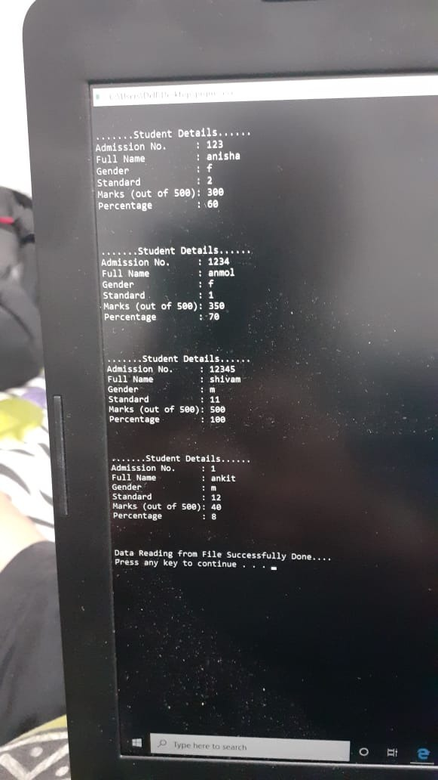

Slide 18
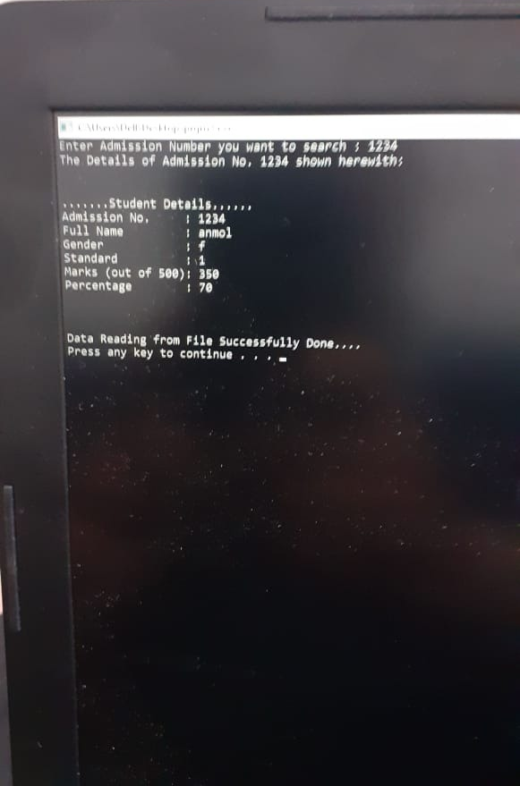

Slide 19
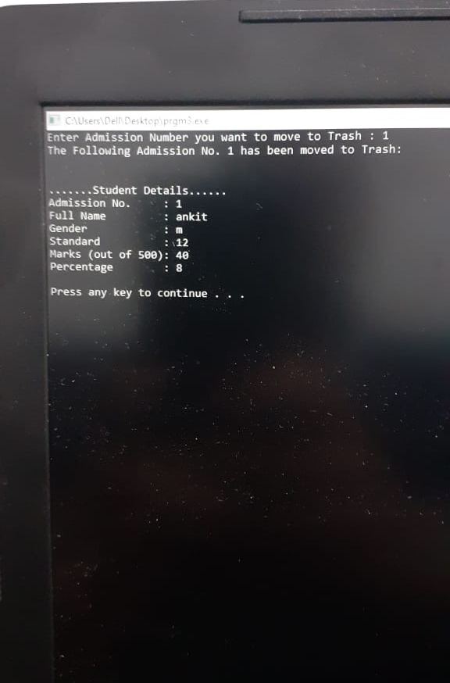

Slide 20
